Slide 1

.NET Core in the world of Microservices

Slide 2
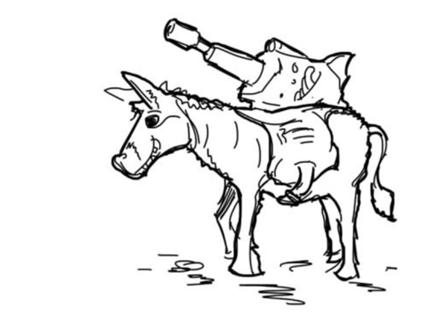
Remember this?
C# is a powerful laser rifle strapped to a donkey, when taken off the donkey the laser doesn’t seem to work as well

Slide 3

What has changed?
Open source
Platform agnostic
Fast
Scalable
Cloud ready

Slide 4
Principles of Microservices
P1: Modelled Around Business Domain
Orders
Basket
Catalog
Identity
Microservices are small Autonomous services that work together (Sam Newman)

Slide 5
Principles of Microservices
P2: Culture of Automation
Infrastructure Automation
Automated Testing
Continuous Delivery

Slide 6
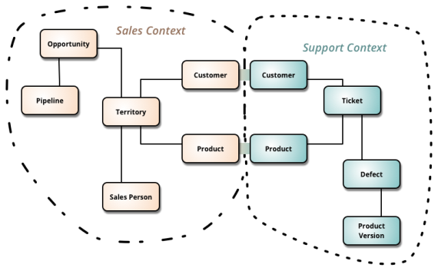
Principles of Microservices
P3: Hide Implementation
Yes
No
DB
What if I update a field?

Slide 7
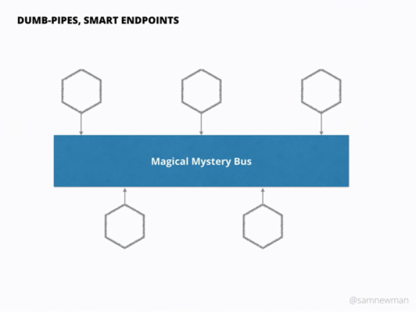
Principles of Microservices
P4: Decentralize all the Things
Autonomy
Self service
Avoid middleware
If use Event Bus
keep it simple

Slide 8
Principles of Microservices
P5: Deploy Independently
Host
Service
Shipping
VS
Host
V1 Endpoint
Service
Service
Customer Service
V2 Endpoint
Service

Slide 9
Principles of Microservices
P6: Consumer first
Make them easy to consume
Documentation – SWAGGER

Slide 10
Principles of Microservices
P7: Isolate Failure
Resilience
Circuit breakers
Short timeouts (people will not wait 2 minutes on a page)

Slide 11
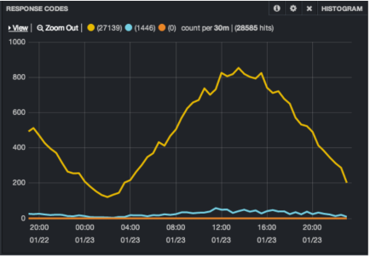
Principles of Microservices
P8: High Observable
Keep logs on the same place
Splunk – high price
ELK – open source
Create stats and time lines
Correlations IDS

Slide 12

Demo time
.NET Core platform independent
Basket
Price Update
Price Catalog
Kafka
Save New Price
DB
DB

Slide 13
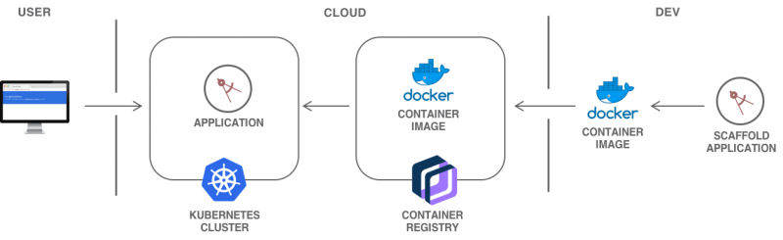
Demo time
Scaling your application with Docker and Kubernetes

Slide 14
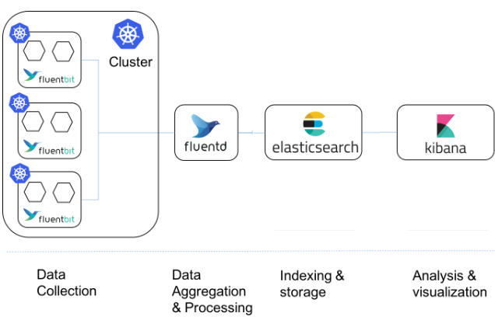
Demo time
Some metrics with Kibana

